Slide 1


Empowering on-chain data with NLP.

Slide 2
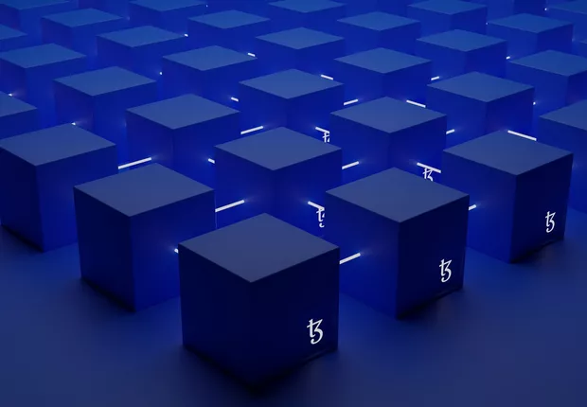
The Concept of Blockchain
Every event is recorded immutably across decentralized nodes.
A trustless network for verifiable data and transactions.
Yet, accessing and interpreting this data remains complex.

Slide 3
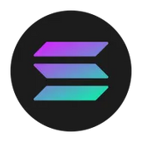

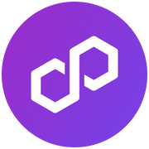
  Dozens of blockchains, fragmented data structures.
  Developers rely on RPC providers and indexers.
  Current tools lack an SDK-level standard for developers
The Current Market
SOLANA
ETHEREUM
POLYGON

Slide 4
On-chain data is hard to query, standardize, and interpret.
01
The Problem
Developers waste time building custom parsers.
02
There’s a gap between raw blockchain data and useful insights.
03

Slide 5
Built on Helius RPC with high-level, human-readable abstractions.
The Solution
SWQuery SDK: a unified way to query Solana on-chain data.
Designed for analytics, compliance, and dApp developers.

Slide 6
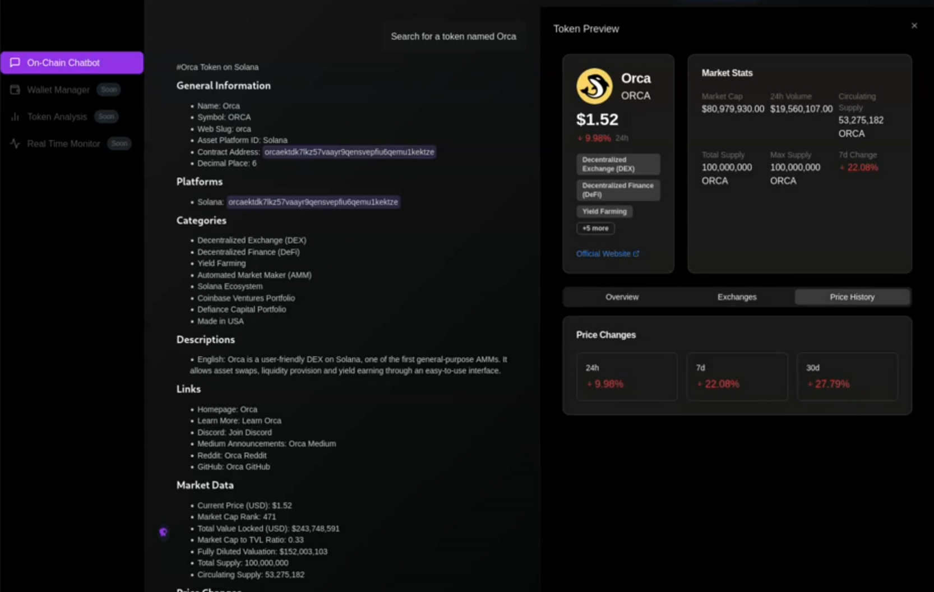
How We Solve It

Slide 7
  Transaction Retrieval Analysis
  Account and Asset information
  Market Insights(trending tokens)
  Subscription based updates
  Rug Check
  Prompt to Swap
Features

Slide 8
  Developers building analytics or Solana-integrated apps.
  RPC Providers and Block Explorers.
Target

Slide 9
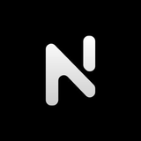

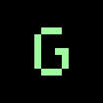


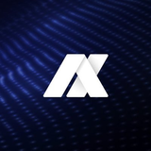

Why SWQuery
Abstraction Layer
Infrastructure
Research Analyst Agent
Defi Optimization

Slide 10
Business Model
Freemium
  3 free requests
  Starter: $10 USDC → 20 requests
  Basic: $30 USDC → 50 requests
  Pro: $50 USDC → 80 requests

Slide 11





Our team
VICTOR CARVALHO
ARTHUR BRETAS
PEDRO HAGGE
MARCELO FEITOZA
MATHEUS MACEDO

Slide 12
Thank you!

